Slide 1
Microglial scRNA Cluster Annotation
Jieran Sun
Bilge Ugursu, Susanne Wolf
03/01/2024

Slide 2
Outline
Project Overview
Pipeline and methodology
Results and deliverables

Slide 3
Project Overview
Objective:
Given the 3 microglial scRNA datasets, develop a pipeline for preprocessing, clustering and annotation, and summarize the expression information of target marker gene across different clusters/cell types.
Deliverables (previously agreed on):
Data preprocessing: Violin plot, PCA selection, Integration & cluster UMAP
Cluster expression: Heatmap per cluster/cell types, table for cell type ranking
Cell type annotation: Annotated UMAP, cell type/cluster-dataset composition tilemap
Marker gene expression: Heatmap/Violin/Ridge plots, top gene expression table
Code: Reproducible R pipeline that can generate all these visualizations above
Notes:
During the two months of my work
, Bilge and I work and meet 1-2 times a week to make sure the results we come up with align with what we expected, and also that the annotation results are interrpretable and make sense. And here are the list of deliverables that we previously agreed on

Slide 4
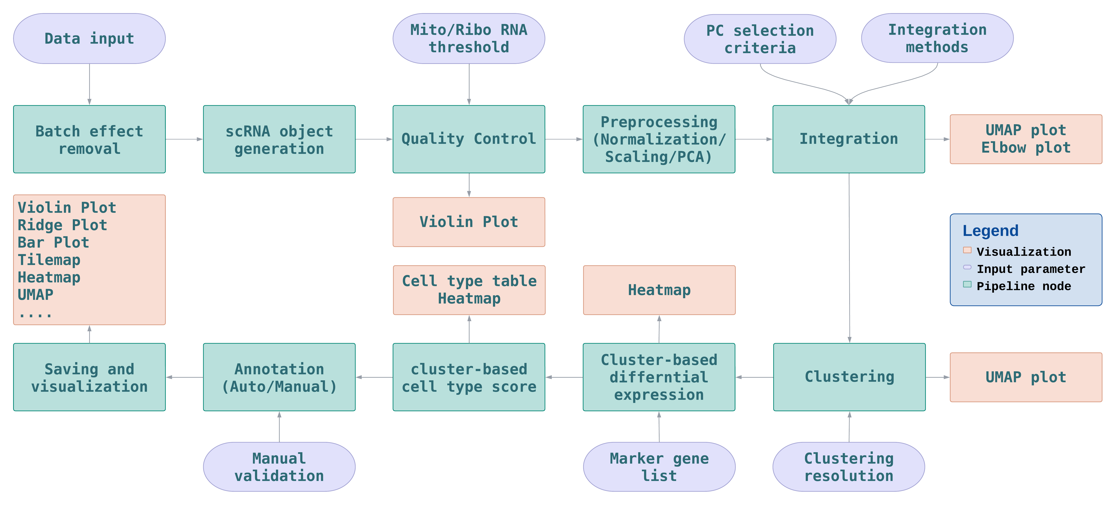
Pipeline and Methods
Deliverable I: Reproducible pipeline with 706 lines of code.
Notes:
Be brief with the information
Batch effect -> coming from the same batch

Slide 5
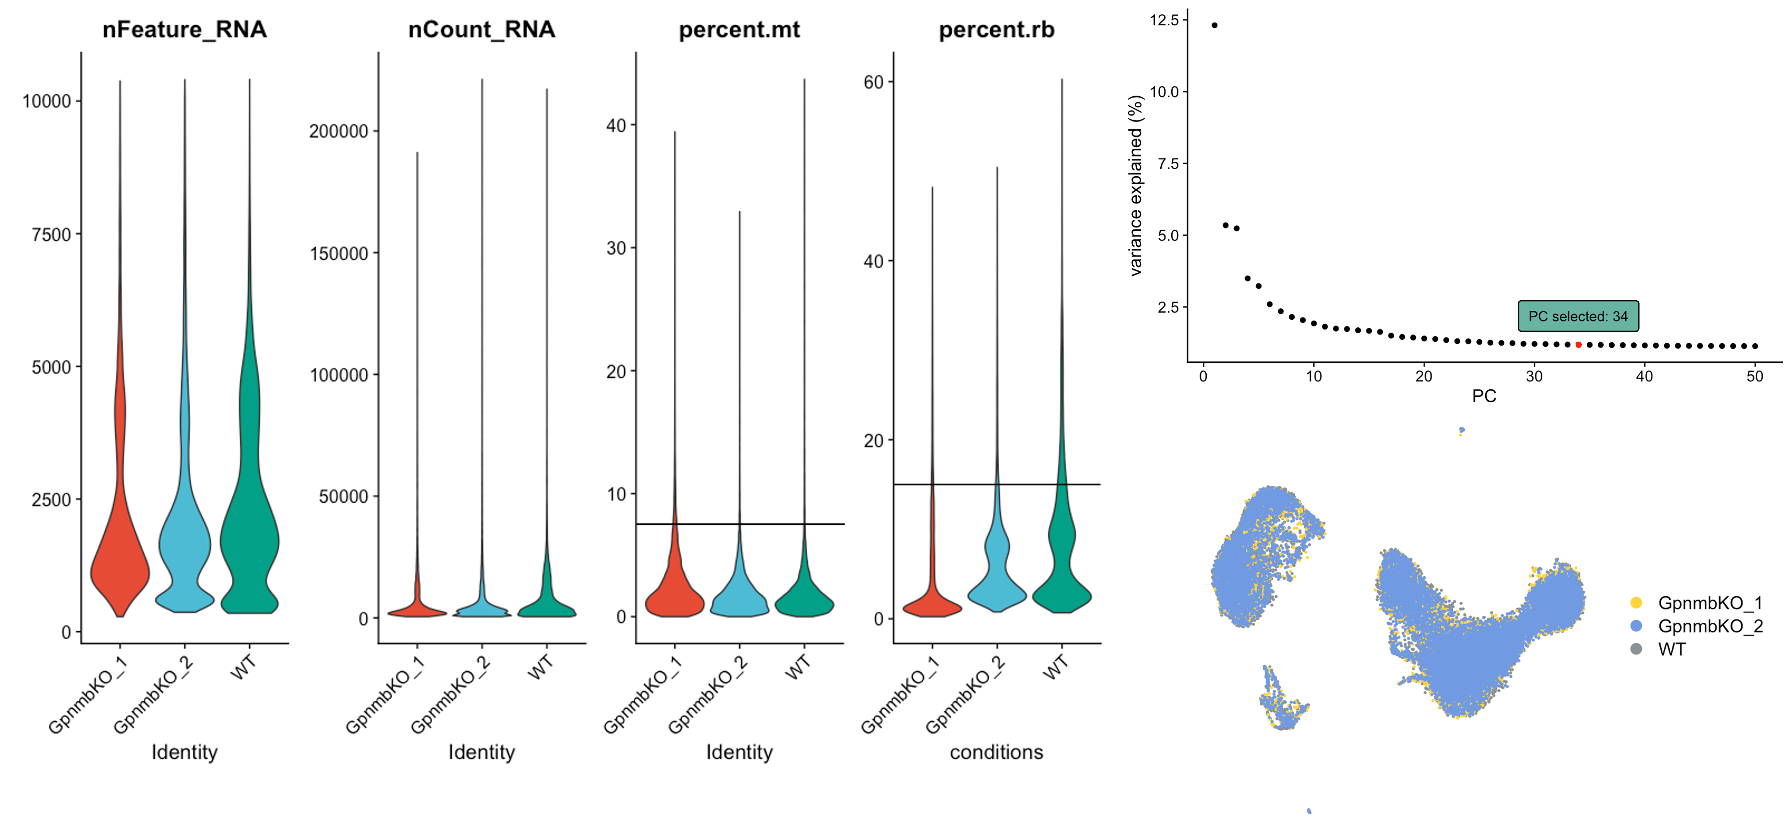
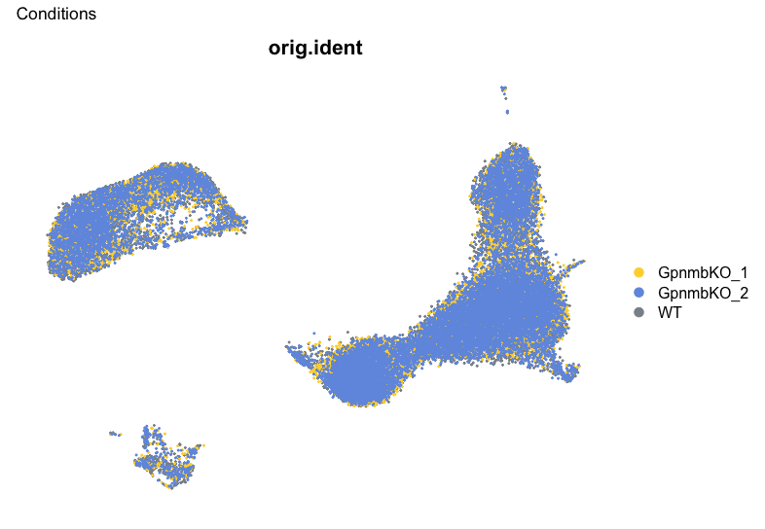
Deliverable: Pre-Processing
Various threshold parameters are tested out and set, eventually mt = 7, rb = 15
Notes:
Change the filtering thresholds for the mt and rb (different strategies)
-> wording let her know the process
7 and 15 (best results)

Slide 6
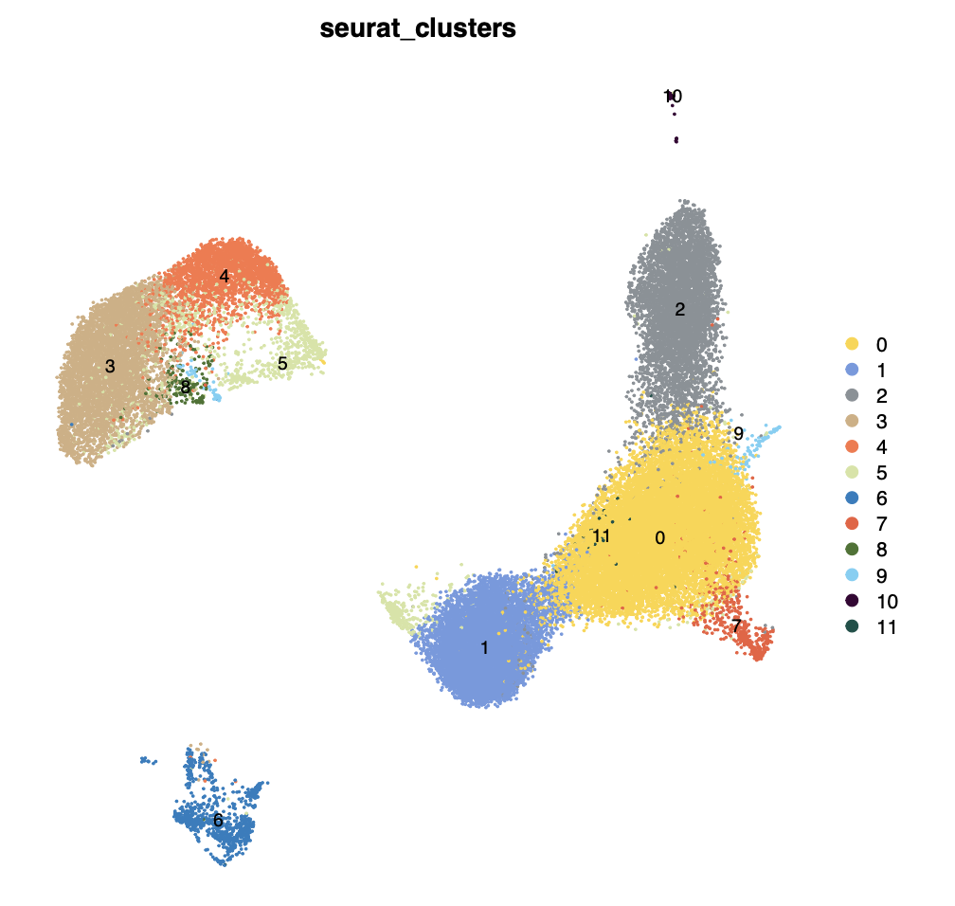
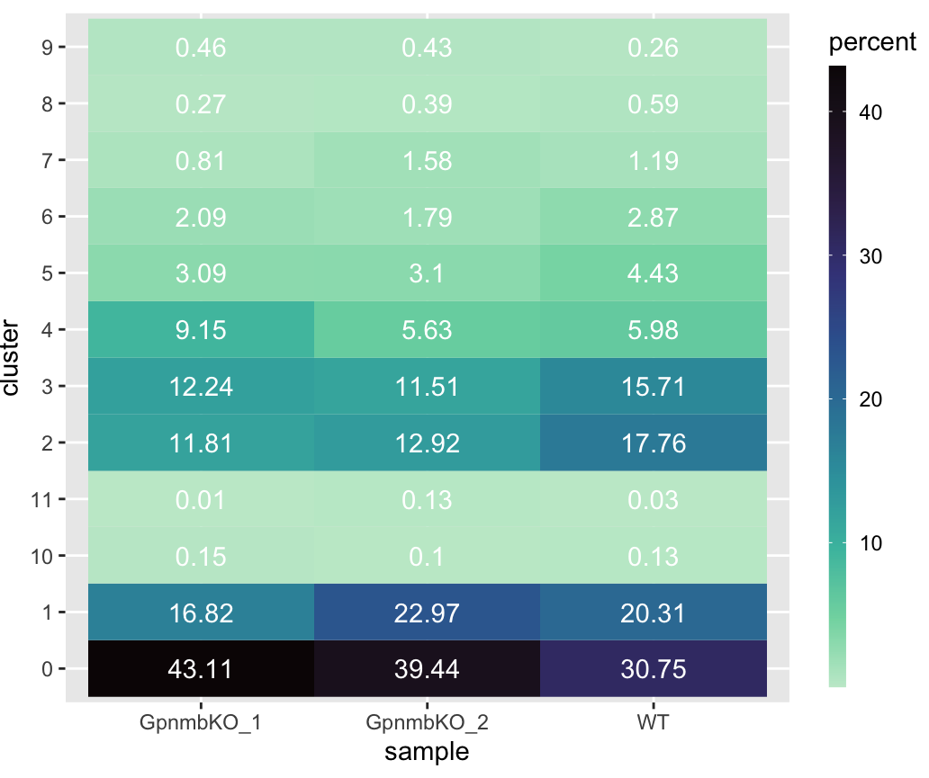
Deliverable: Cluster

Slide 7
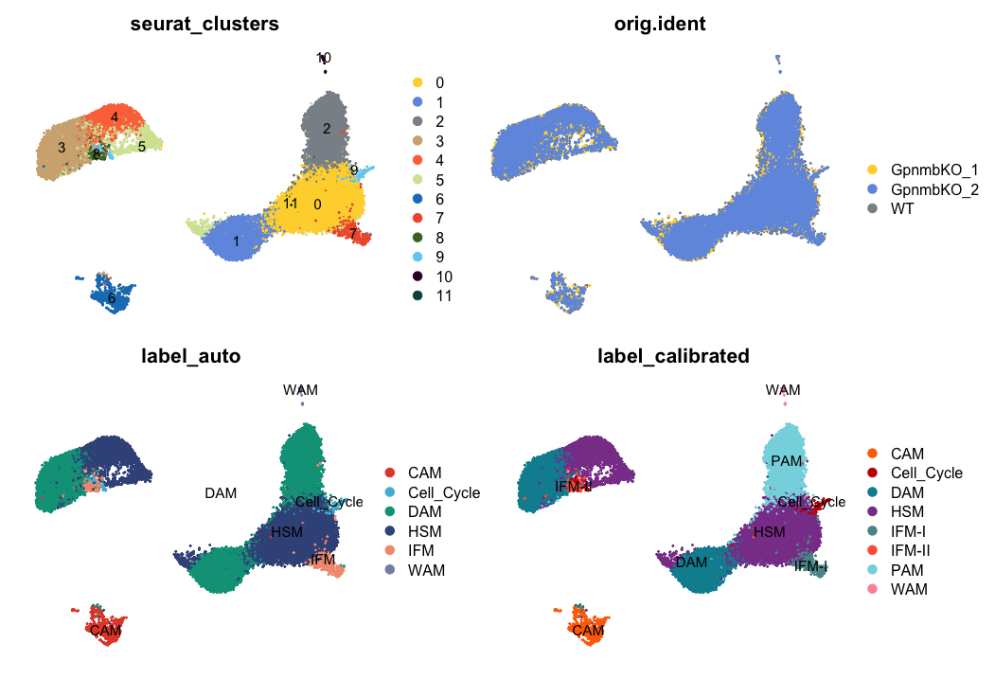
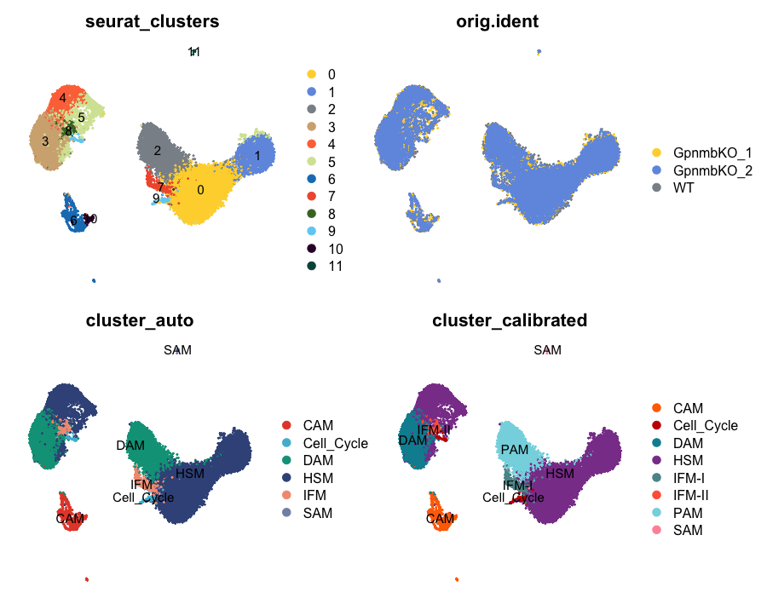
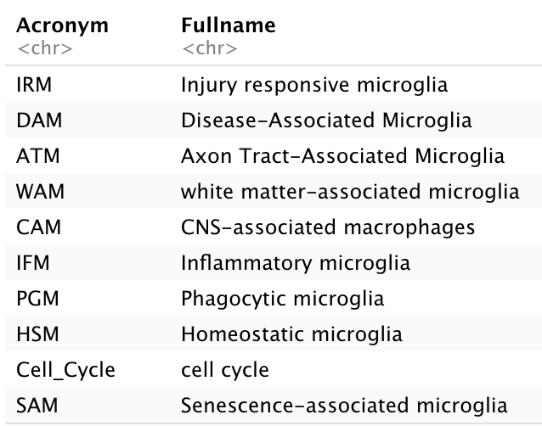
Deliverable: Cluster

Slide 8
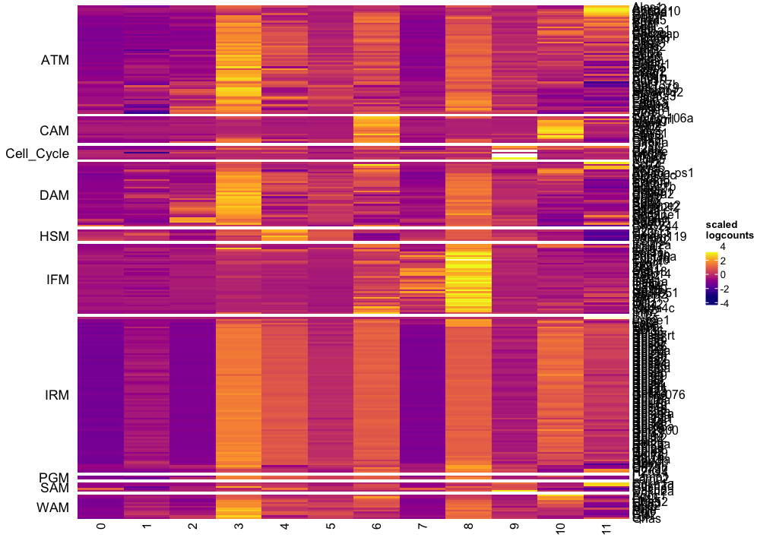
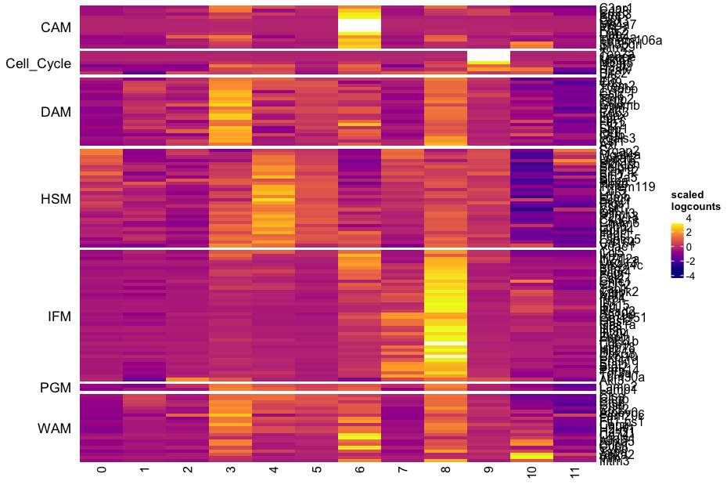
Deliverable: Marker Heatmap
Old vs New marker gene list:
 | WAM | Cell Cycle | DAM | IRM | ATM | CAM | IFM | PGM | HSM
Old | 15 | 7 | 29 | 113 | 69 | 2 | 6 | 2 | 5
New | 21 | 7 | 21 | 0 | 0 | 13 | 40 | 2 | 30

Slide 9
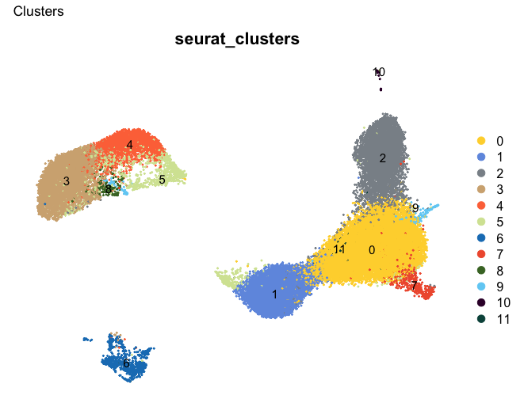
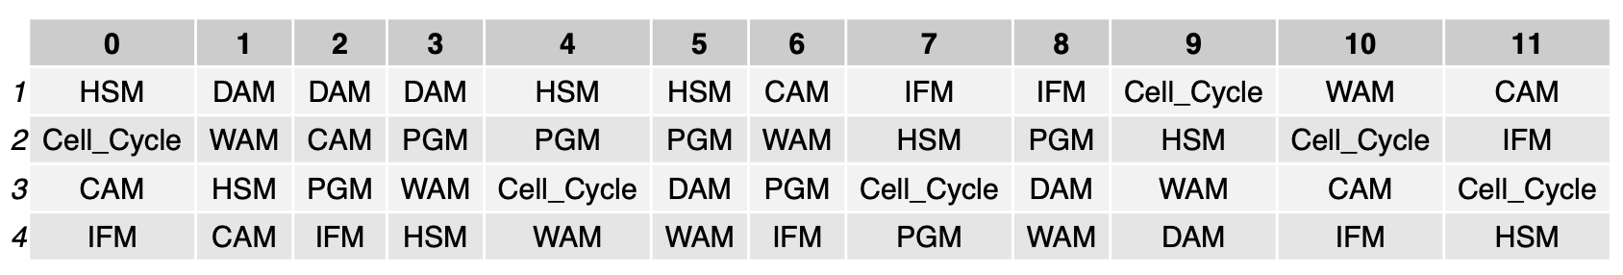
Deliverable: Automatic Annotation

Slide 10
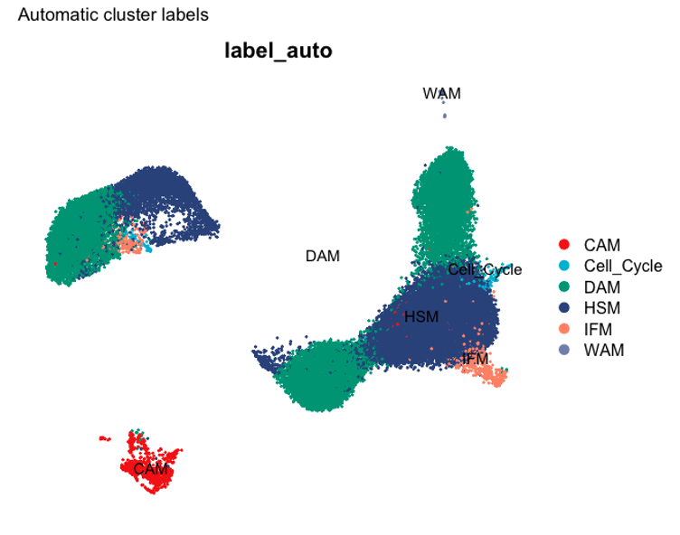

Deliverable: Automatic Annotation

Slide 11
Deliverable: Automatic Annotation
Notes:
Data is clean. Quality is good. This is the cluster results

Slide 12
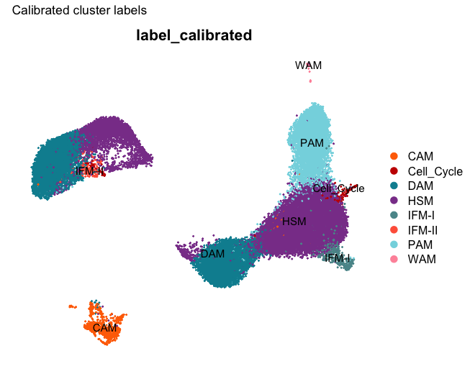
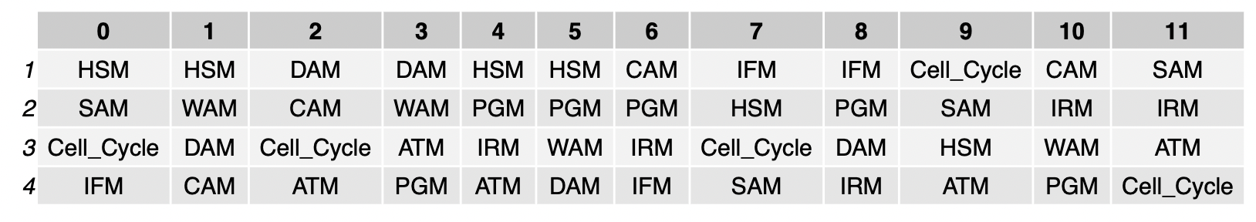
Deliverable: Manual adjustment (with Bilge)
Pre-active Microglia (PAM)
IFM-I
IFM-II

Slide 13
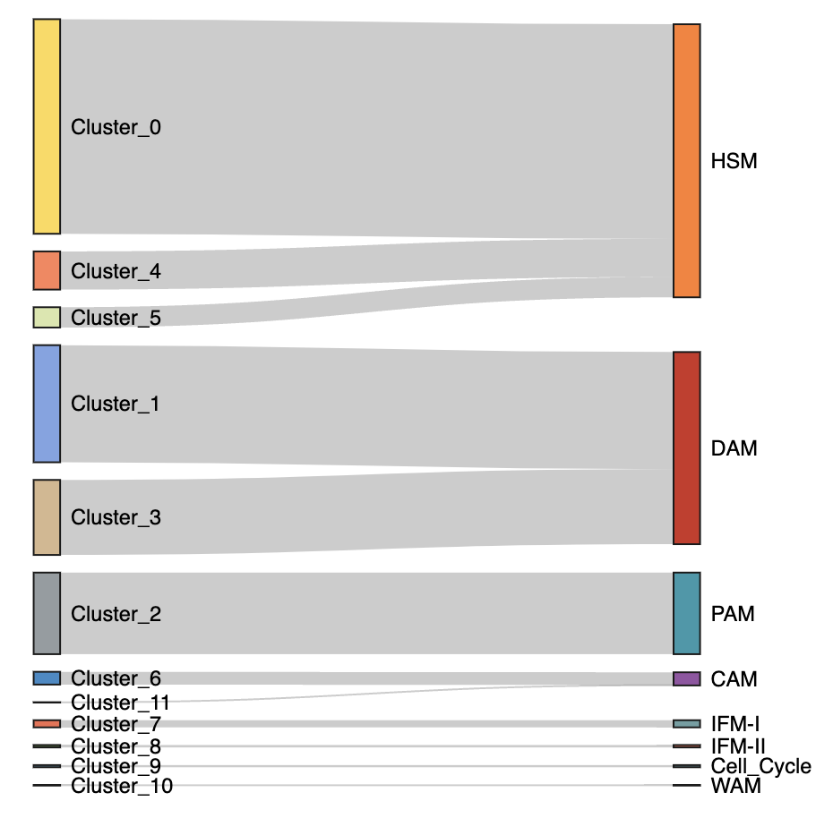
Deliverable: Annotation

Slide 14
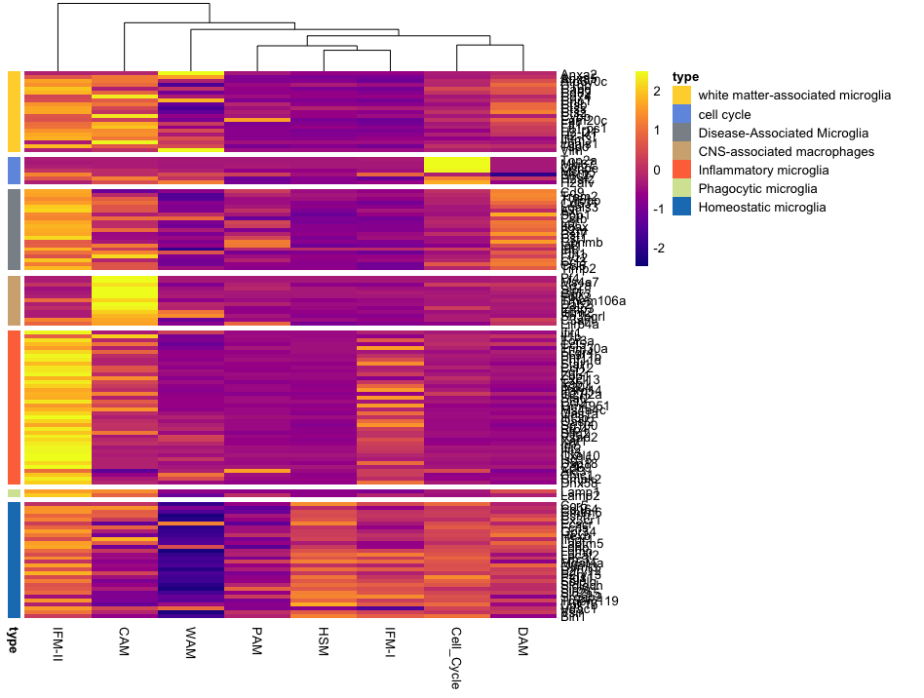
Deliverable: Heatmap
Notes:
Just focus on the cell type heatmap

Slide 15
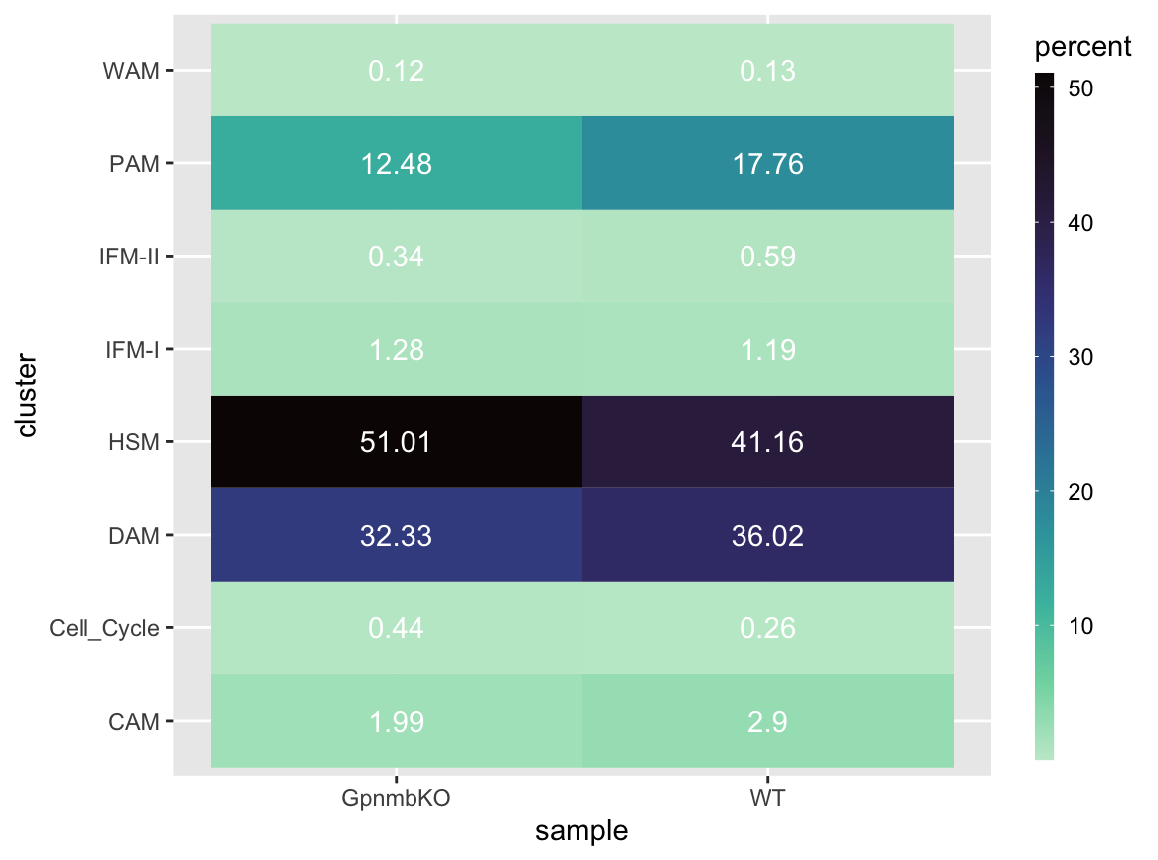
Deliverable: Composition
Notes:
Just focusing on the right side one
Change the color of the label

Slide 16
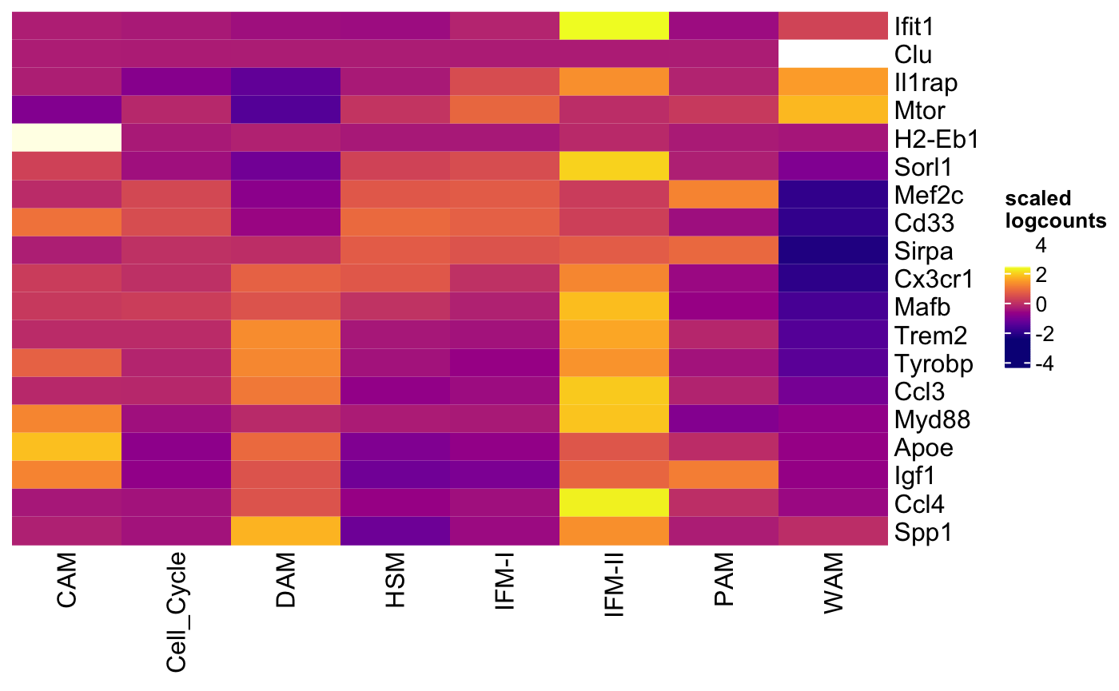
Deliverable: Selected gene heatmap

Slide 17
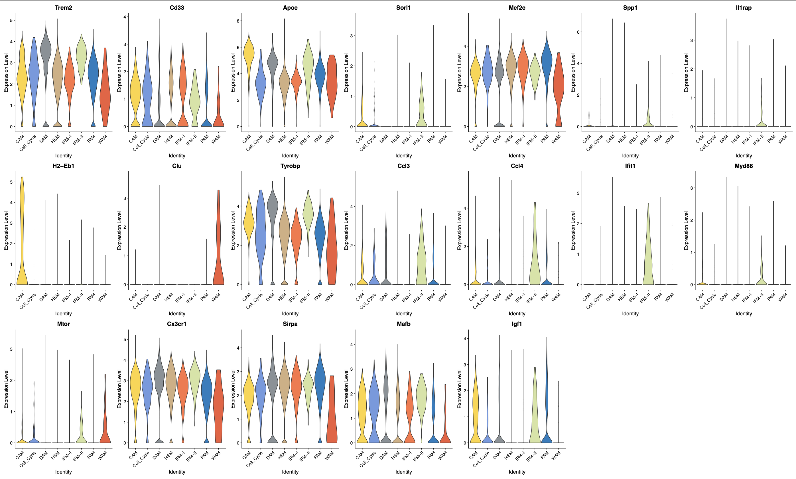
Deliverable: Violin Plot (Cell type)
Notes:
Bar plot (write the cell type)

Slide 18
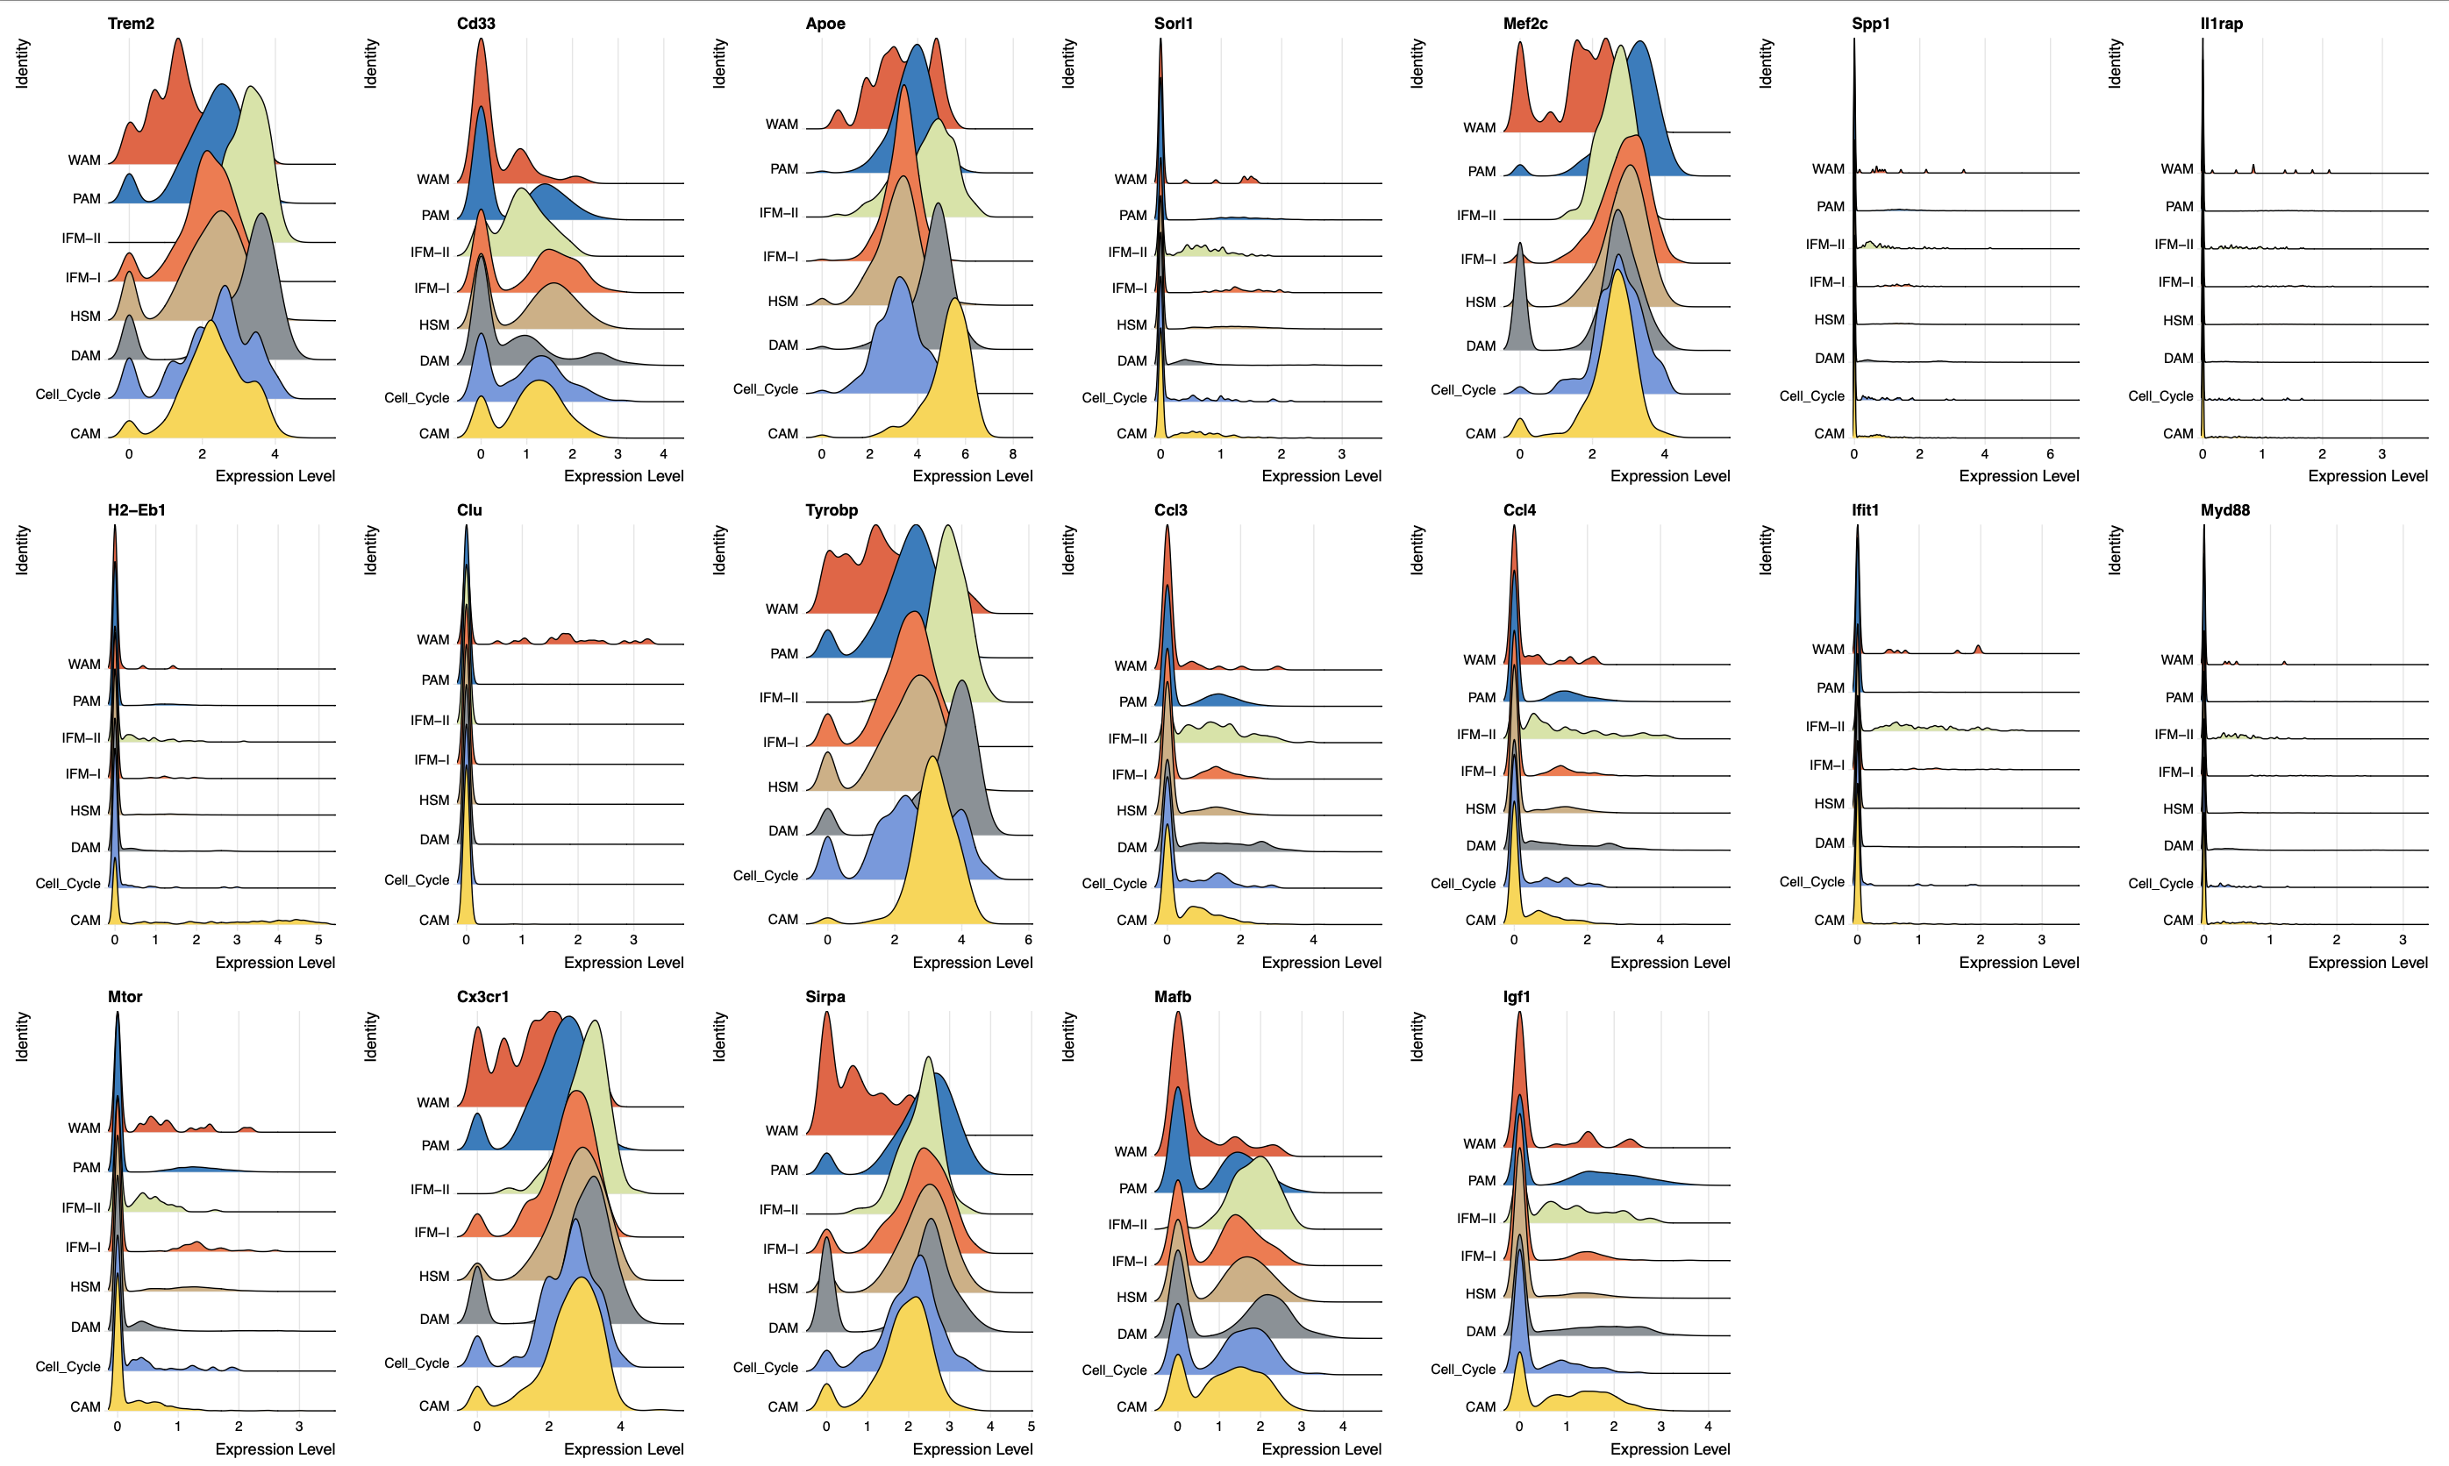
Deliverable: Ridge Plot (Cell type)
Screenshot 2023-11-17 at 10.57.13
Notes:
Bar plot (write the cell type)

Slide 19
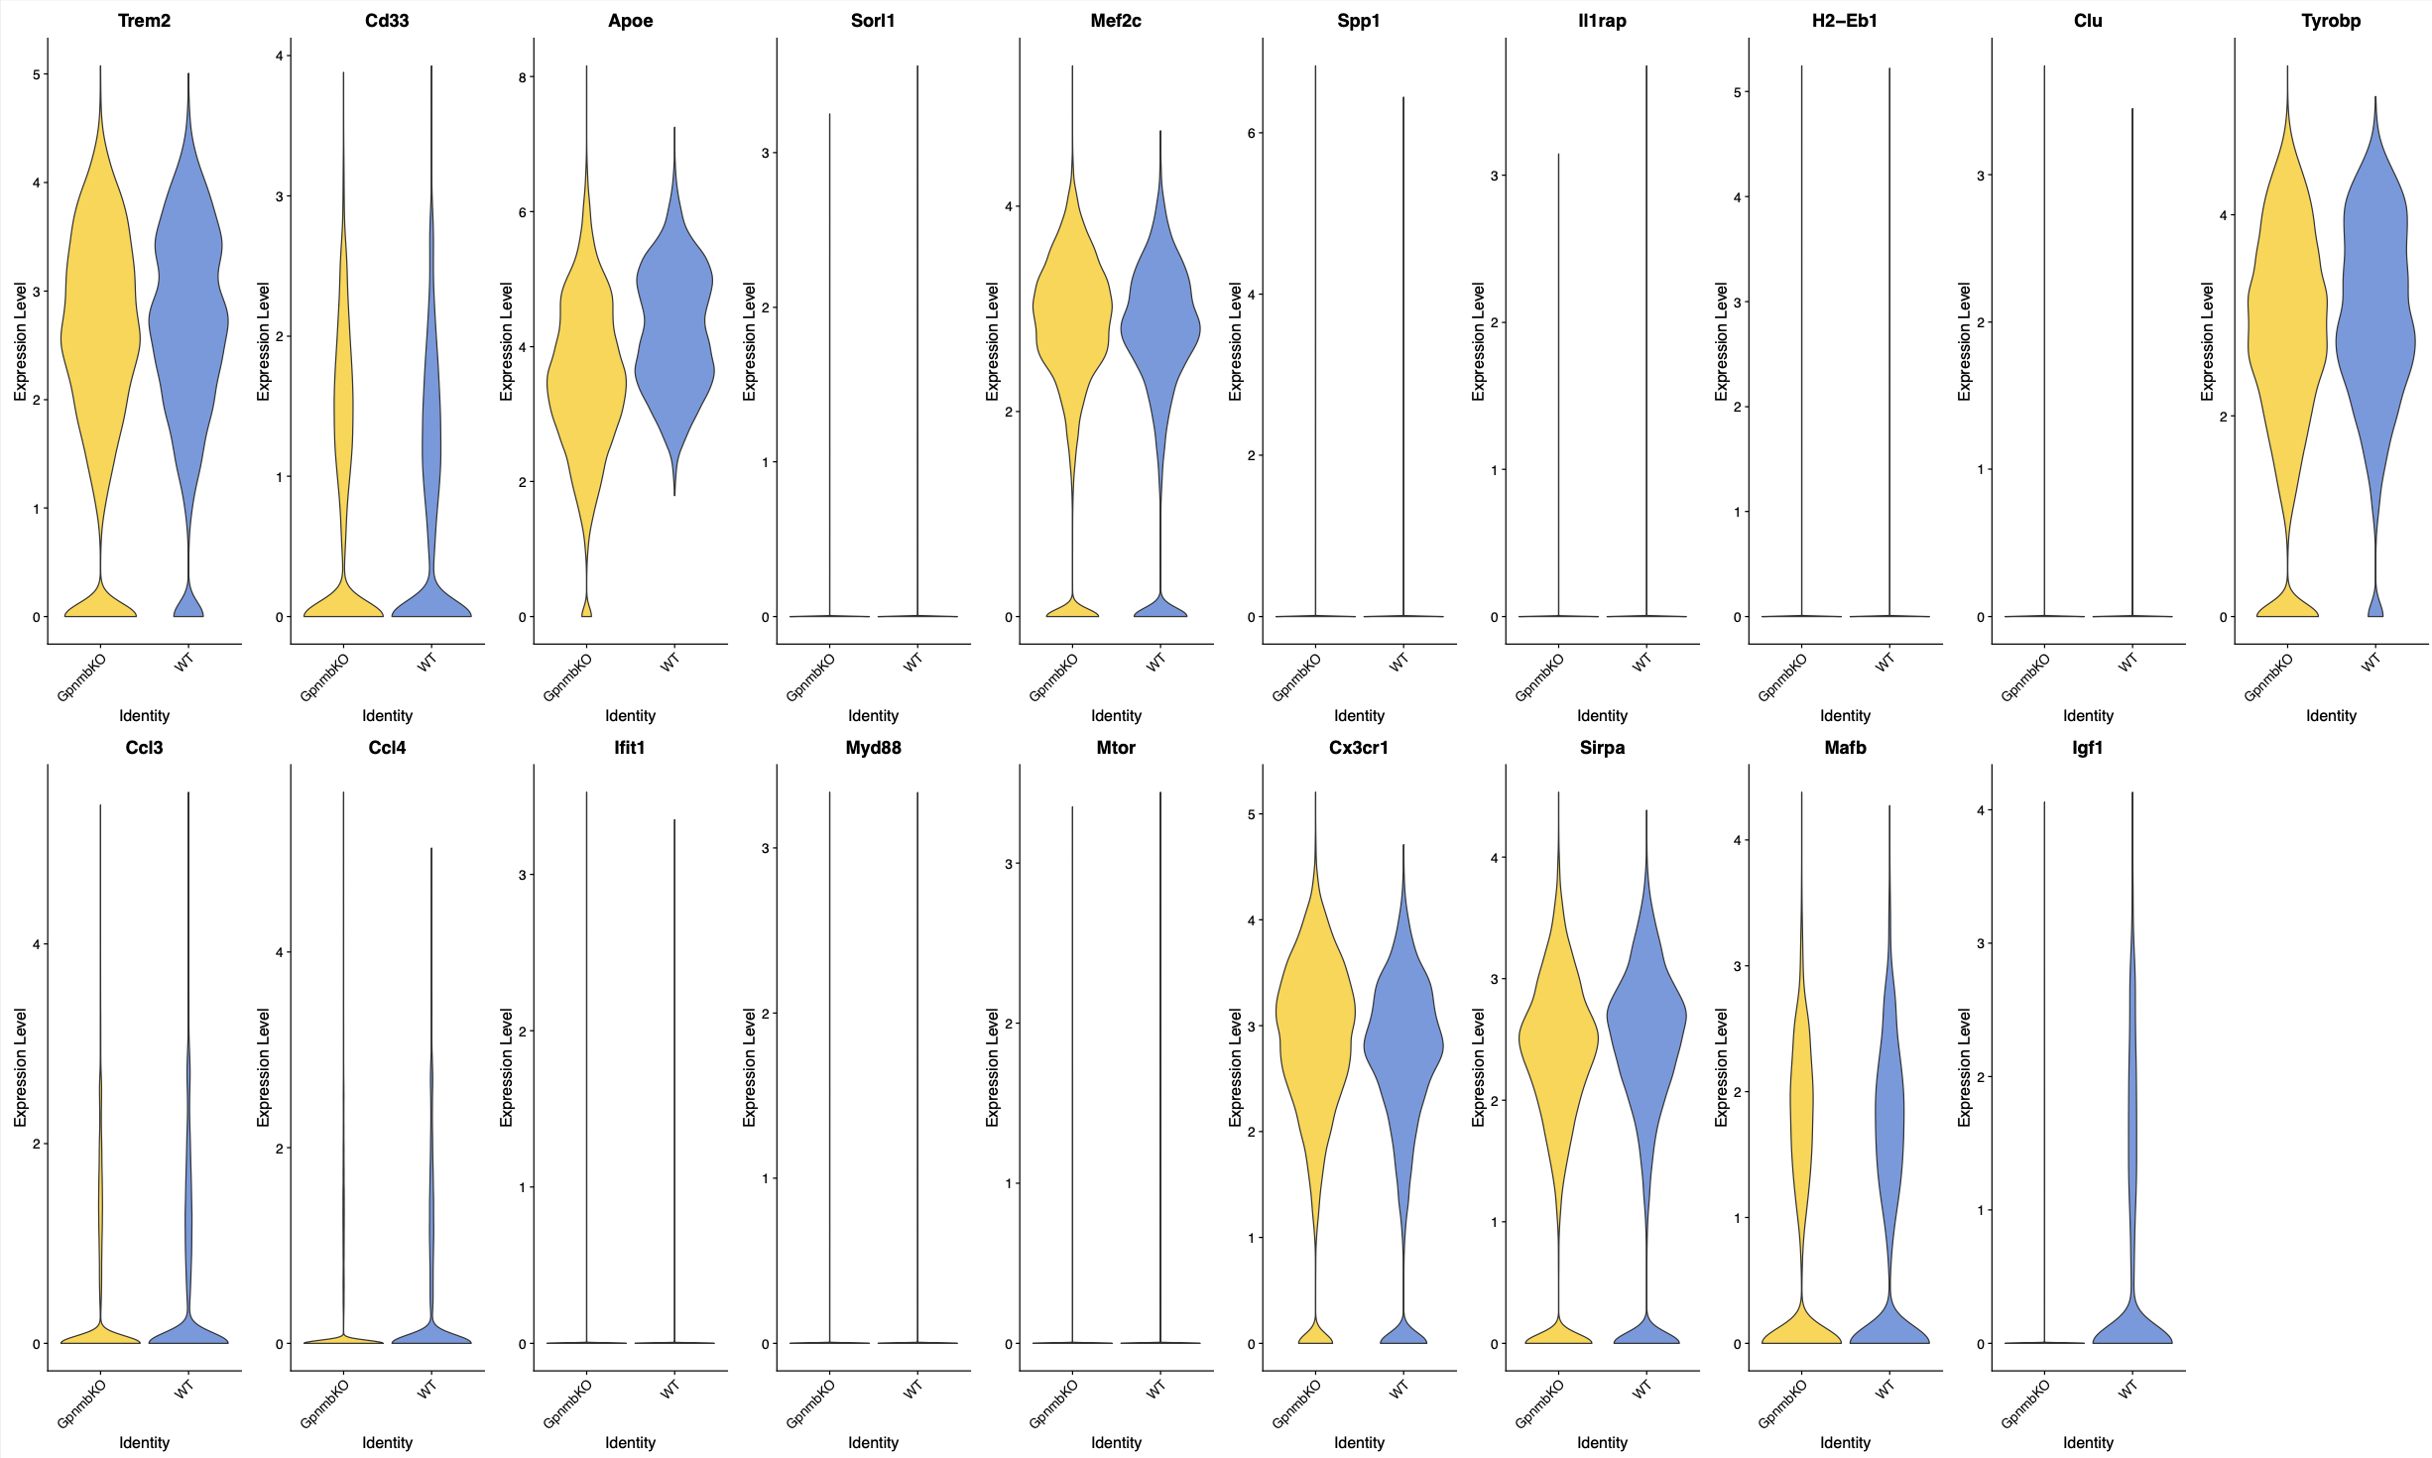
Deliverable: Violin Plot (Dataset)
Notes:
Bar plot (write the cell type)

Slide 20
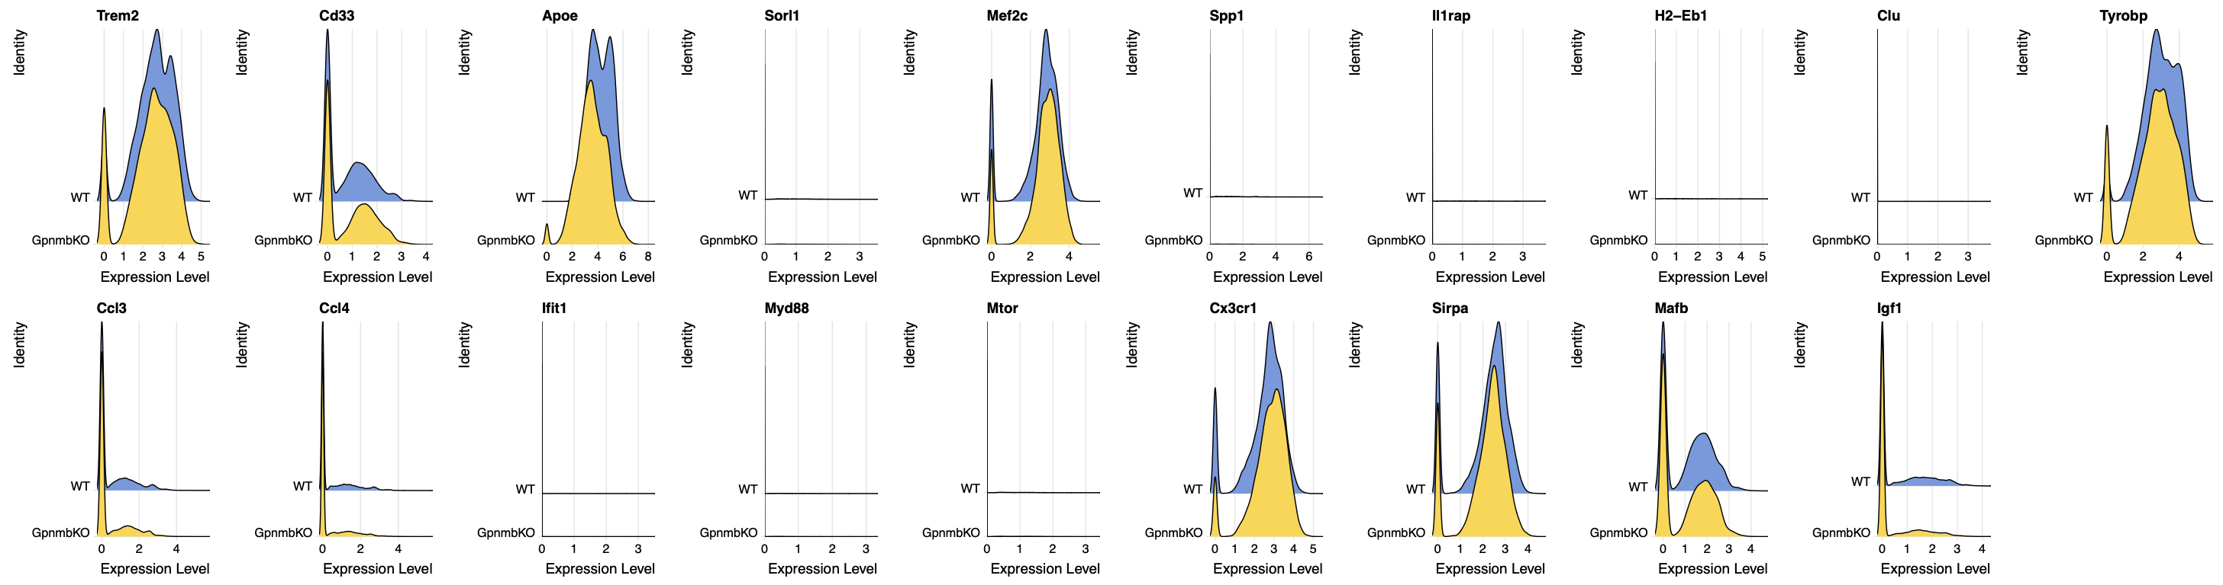
Deliverable: Ridge Plot (Dataset)
Notes:
Bar plot (write the cell type)

Slide 21
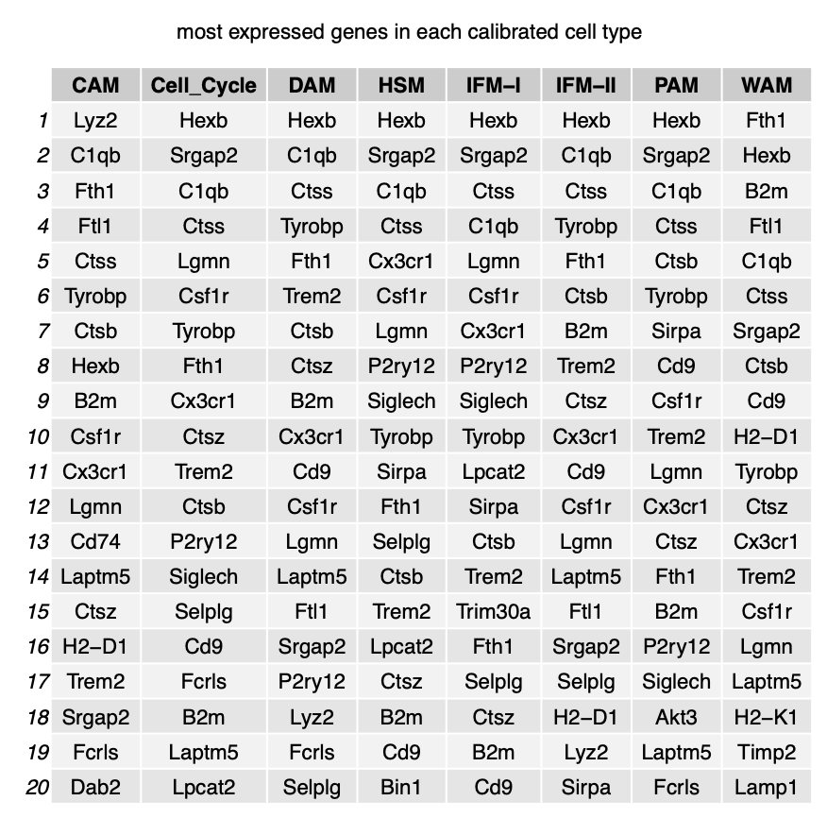
Deliverable: Top gene expression

Slide 22
Thank you.

Slide 23
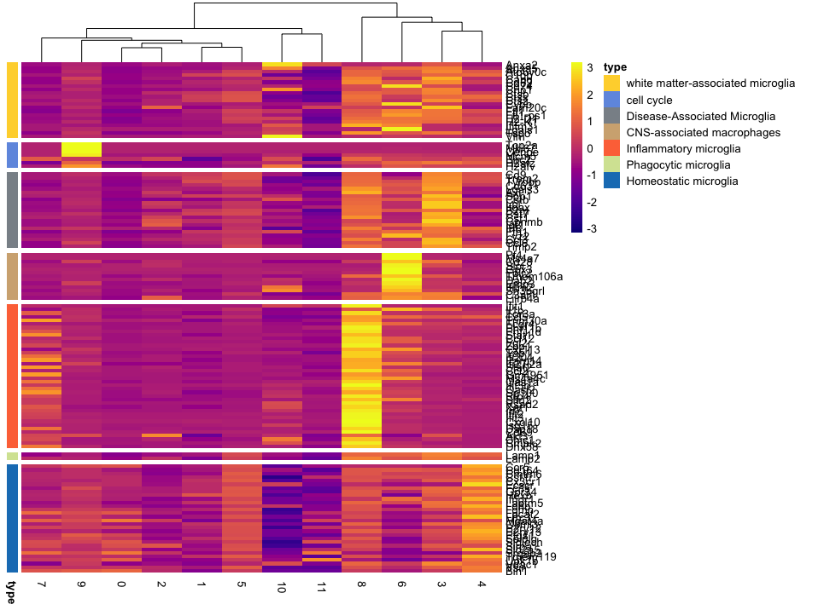

Slide 24
